Slide 1
Current modules

Slide 2
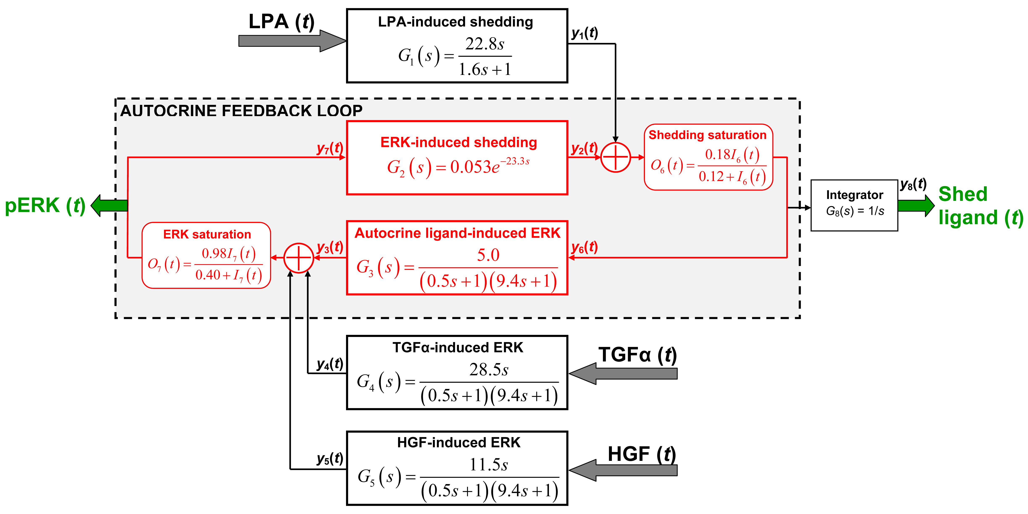
A transfer-function model of ERK signaling

Slide 3
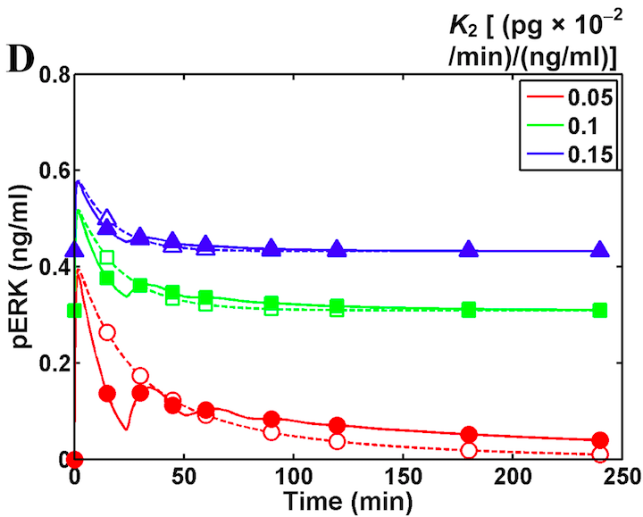
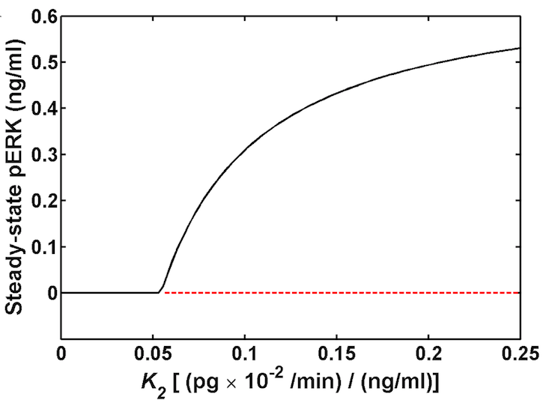
Our model predicted impact of feedback strength
Impact of increased shedding feedback
Alterations in steady state pERK levels

Slide 4
You can build a mechanistic model of a module if there is sufficient data

Slide 5
Mechanism of TACE (ADAM17) activation
iRhom

Slide 6
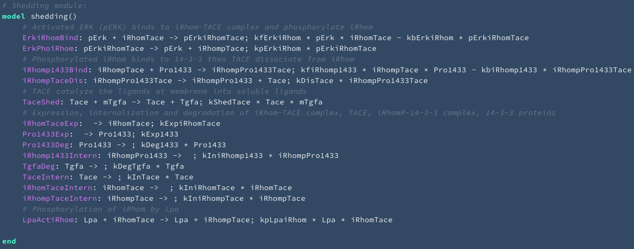
The ligand shedding module

Slide 7
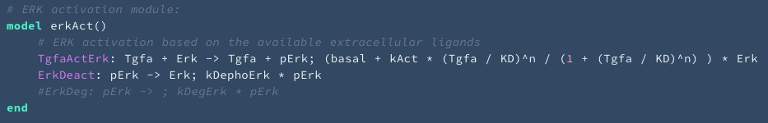
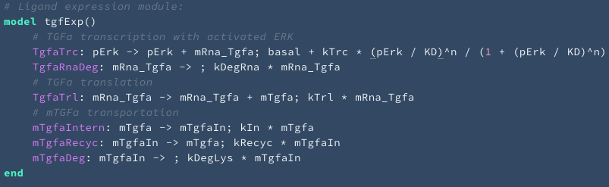
The TGFa expression and ERK activation modules

Slide 8
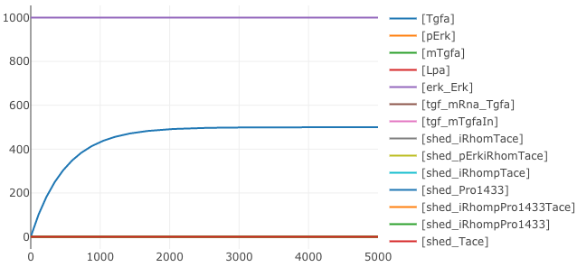
Test simulations: equilibrium(no TGFa)

Slide 9
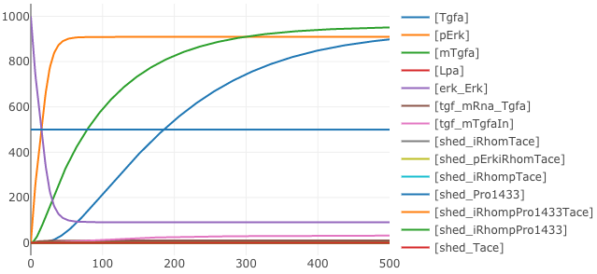
Test simulations: add TGFa

